Slide 1
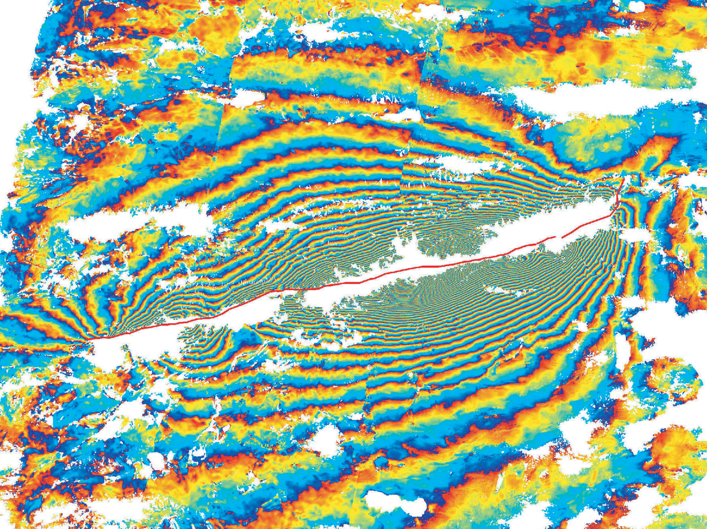


How does InSAR work?
Modified from slides by Gareth Funning (UC Riverside) and the 2022 UNAVCO ISCE short course
Notes:
This is designed as a read-it-yourself guide to the basics of InSAR, a technique that can be used to image the movement of Earth’s surface at high resolution.

Slide 2
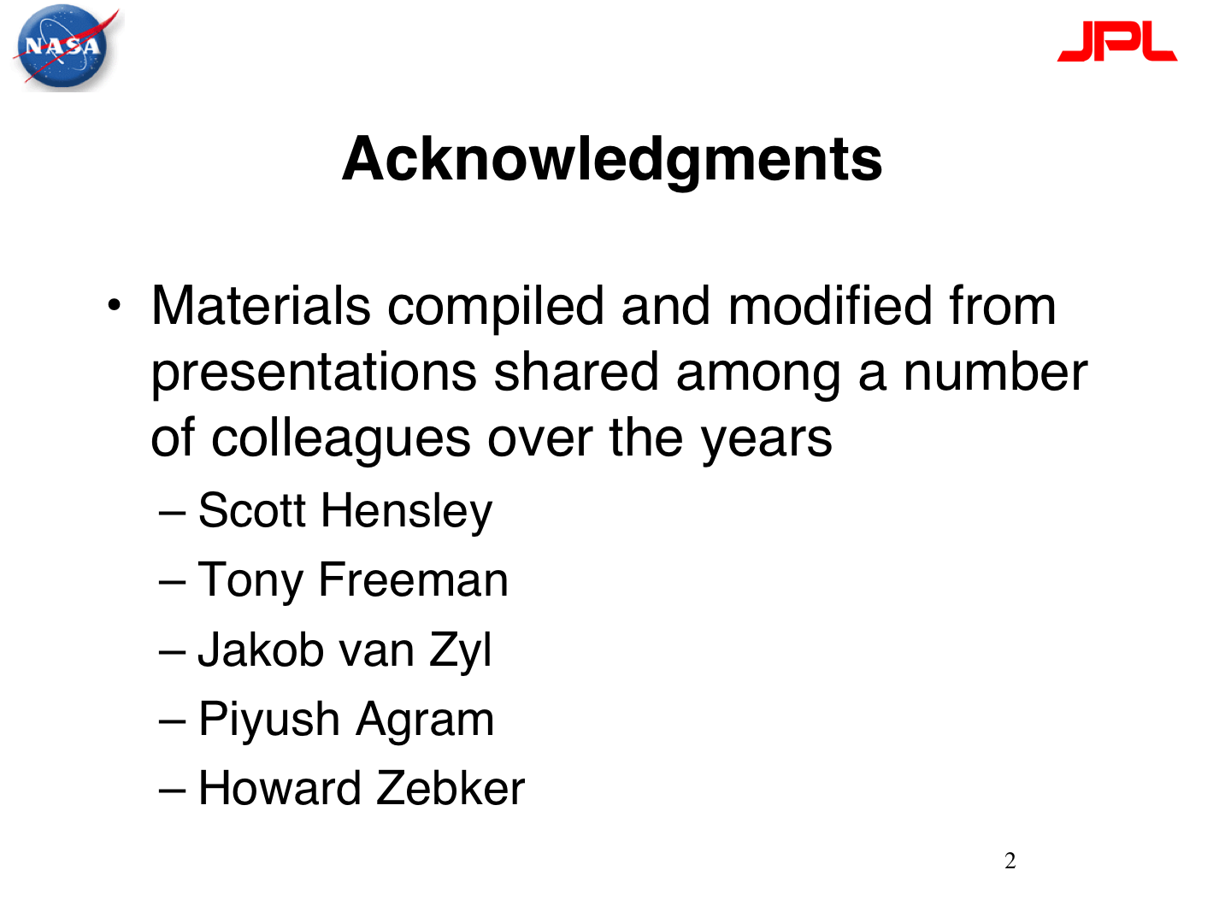
https://github.com/parosen/Geo-SInC

Slide 3
Interferometric SAR (InSAR) Theory
Interferometric Synthetic Aperture Radar

Slide 4
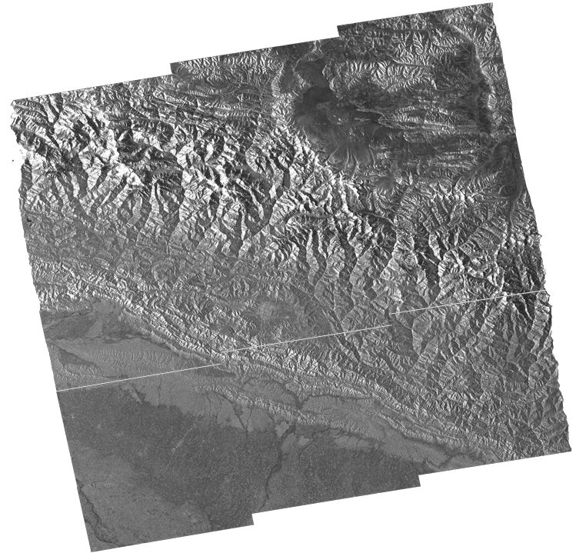
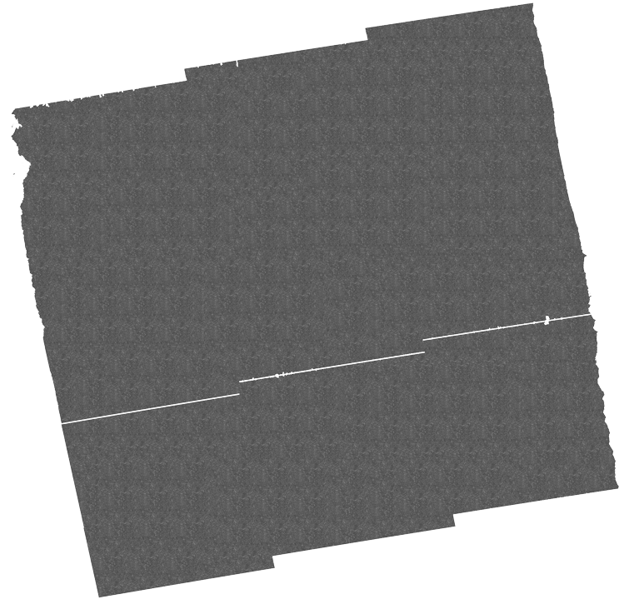
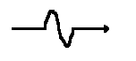
SAR: Synthetic Aperature RADAR
InSAR = Interferometric Synthetic Aperture Radar
v_{flight}
Amplitude (A)
Phase (ɸ)
Synthetic antenna
+
Where we define the distance as:
n whole cycles + a residual phase (ɸ)
Signal is recorded as a complex number:
Z=Ae^{iɸ}
Modified from David Bekaert
Notes:
Resolution is improved from a couple of km to 30 meter

Slide 5
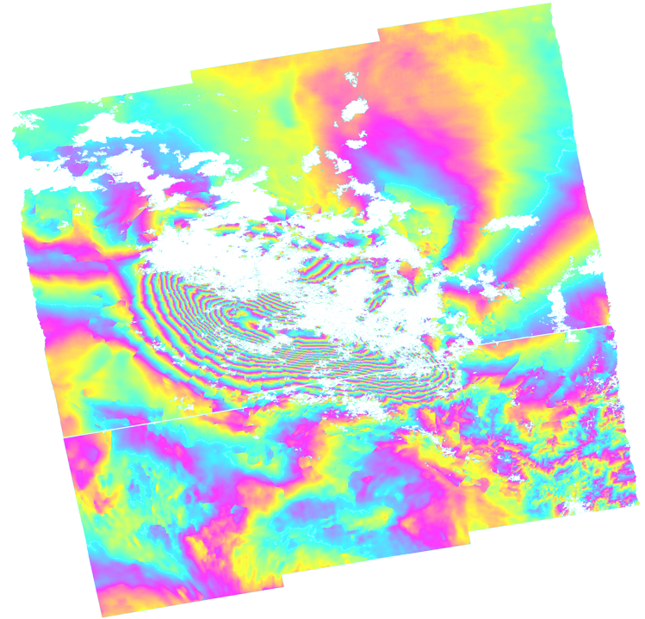
InSAR: Interferometric SAR from differencing two phase images
InSAR = Interferometric Synthetic Aperture Radar
$$φ_{reference}−φ_{secondary}={Δφ}_{interferogram}$$
-
=
Sentinel 1 interferogram by P. Gonzalez
Contains Copernicus data

Slide 6
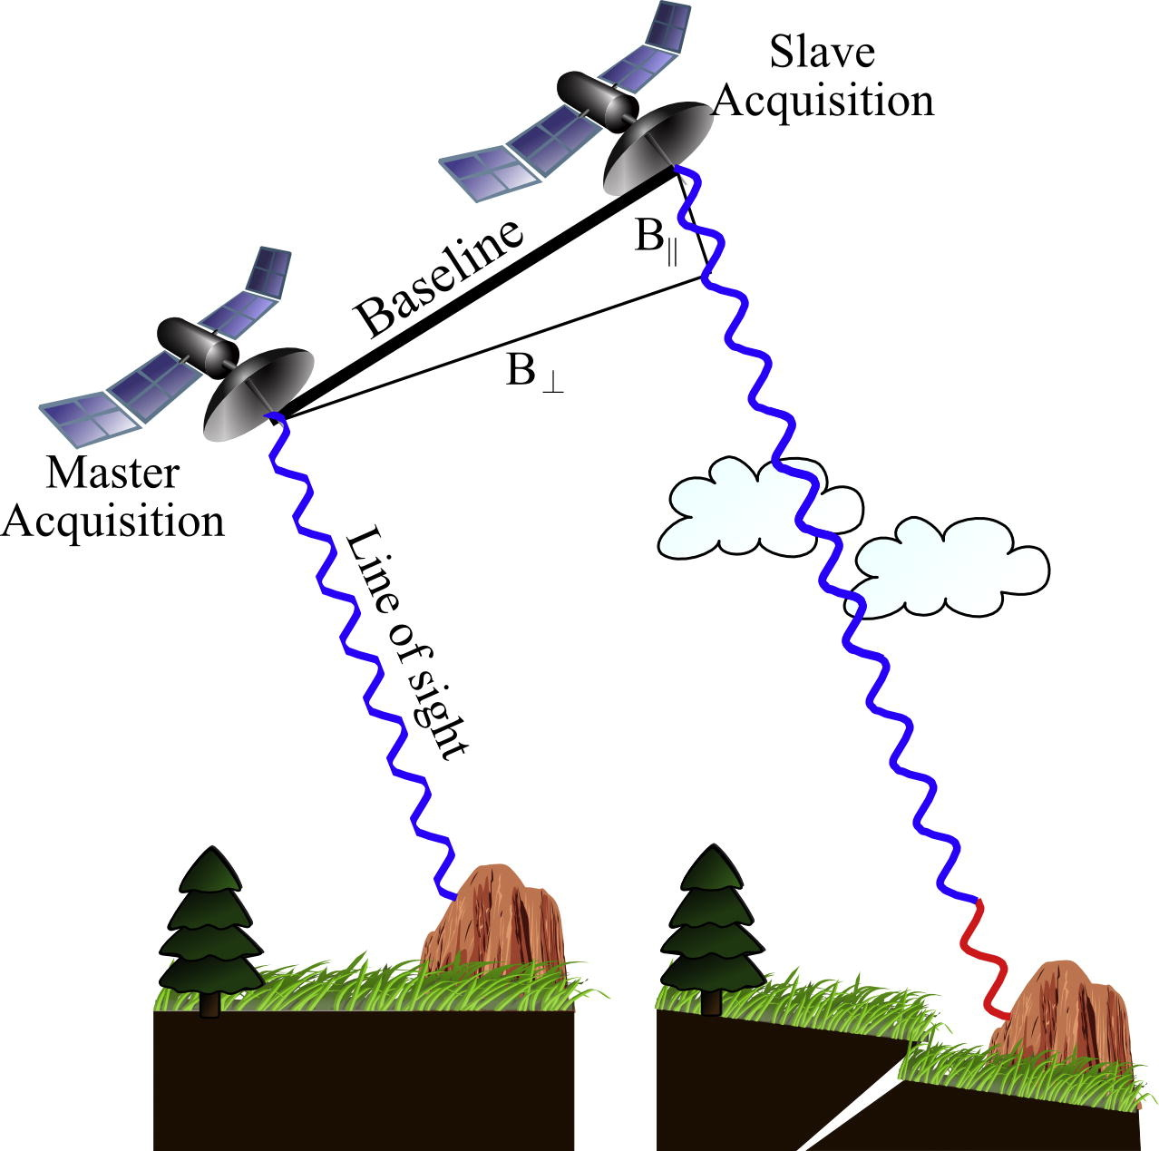
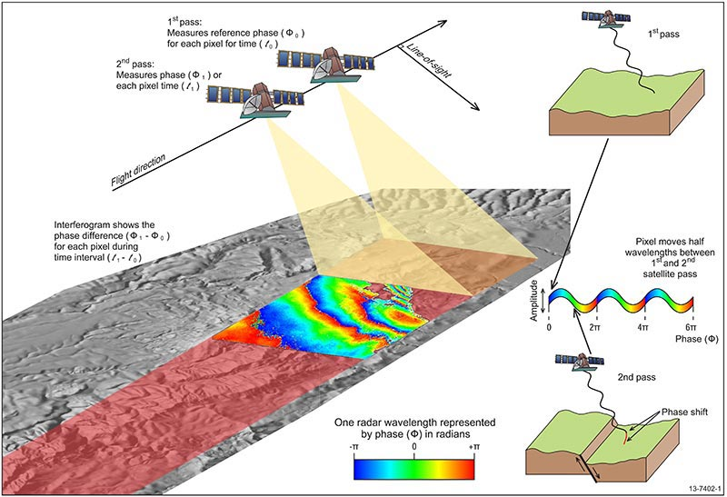
InSAR: Interferometric SAR from differencing two phase images
Osmanoğlu et al., 2016
https://www.ga.gov.au/

Slide 7
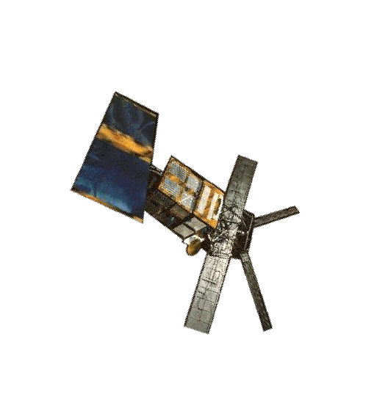
Another view
Phase is a function of the distance from the satellite to the ground.
ERS-1
~6 cm
~780 km
Notes:
Recall that one wavelength of path length is equivalent to 2π of phase. Given that radar satellites orbit at several hundred km of elevation, it is not feasible to count the number of phase cycles for a single image . . .

Slide 8
InSAR: How it works
Pass 1
Pass 2
Notes:
. . . So what we do is compare (difference) the phase from two different passes of the same satellite over the same point on the ground. Assuming that we can correct for the position of the satellite (and we can), then any difference in phase between the two passes must be related to a change in distance between the satellite and the ground (i.e. a movement of the ground).

Slide 9
InSAR: How it works
Pass 1: pre-movement
Pass 2: post-movement
phase=φ₁
phase=φ₂
phase shift due to ground motion
Notes:
So if the ground moves, we can detect a phase shift when we subtract the phase of the second image from the phase of the first!
It is important to note that we can only measure displacement of the ground toward or away from the satellite, in the line-of-sight direction between the two. Everything we measure is a “line-of-sight” displacement.

Slide 10
InSAR: How it works
phase shift varies with distance from the fault
Notes:
It is important to note that the only way we know that there has been movement of the ground is if different areas on the ground move different amounts—InSAR makes measurements of relative deformation. If the whole area moved by the same amount we would not see any relative phase shift. The cartoon here shows a slipping normal fault, and we would expect that the ground would move farther away from the satellite for an area directly next to the fault than an area farther away. The pattern of relative displacement that we see recorded in the InSAR data is typically diagnostic of the deformation source (e.g. for earthquakes, normal, reverse and strike-slip earthquakes all have different and distinct patterns).

Slide 11
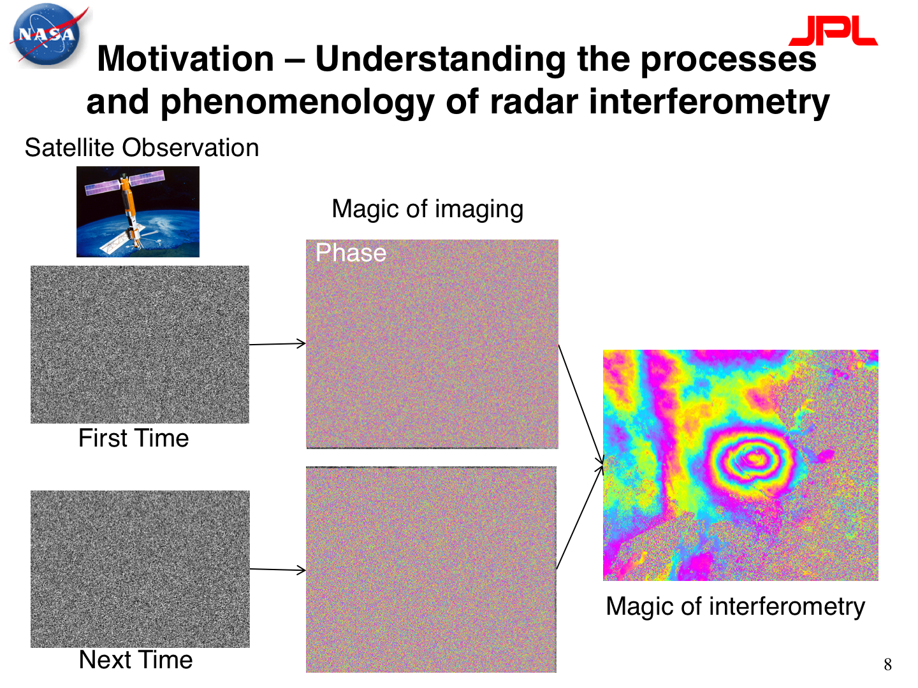

Slide 12
InSAR: Interferometric SAR from differencing two phase images
Osmanoğlu et al., 2016
https://www.ga.gov.au/

Slide 13
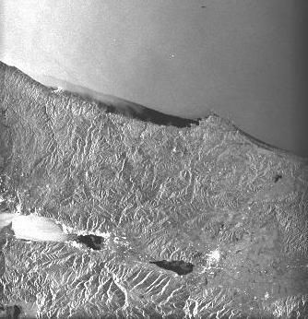

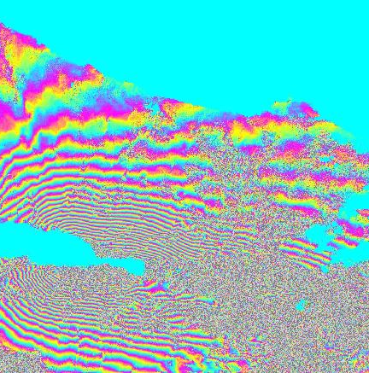

Image A - 12 August 1999
Interferogram = Phase A - Phase B
amplitude
phase
Remove phase from
topography
satellite positions
earth curvature
Image B - 16 September 1999
Tim Wright
Notes:
Here is how we make an InSAR image (we call them “interferograms”).
Two SAR images are shown, amplitudes on the left, phases on the right. They are both from the same area of Turkey, acquired five weeks apart in the summer of 1999.
The amplitude images are used to match and align the two SAR images to each other, to make sure that when you difference the phase, you are differencing the phase for the “same” pixels. The various corrections that are made to the phase rely on having accurate information on the satellite orbits and topography of the area being imaged; however, such corrections are standard during processing, the orbits are closely monitored from the ground (the satellites also often carry dedicated instruments for the purpose), and projects such as the Shuttle Radar Topography Mission (SRTM) project have produced global digital elevation models that can be used to correct for topography.
Image source: Tim Wright (University of Leeds) – used with permission
Learn more about the analysis described here from: Wright, T. J., Parsons, B. E., Jackson, J. A., Haynes, M., Fielding, E. J., England, P. C. and Clarke, P. J. (1999) Source parameters of the 1 October 1995 Dinar (Turkey) earthquake from SAR interferometry and seismic bodywave modelling, Earth Planet. Sci. Lett., 172, 23-37. http://www.sciencedirect.com/science/article/pii/S0012821X99001867

Slide 14
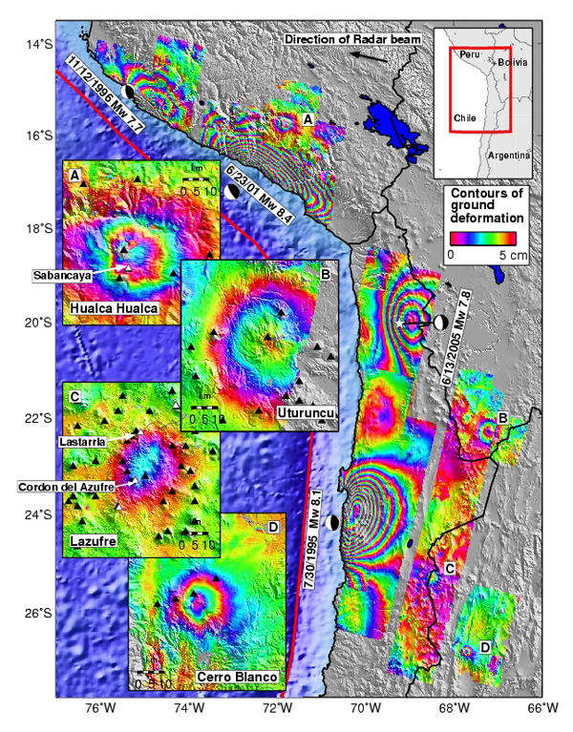
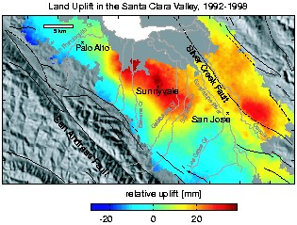
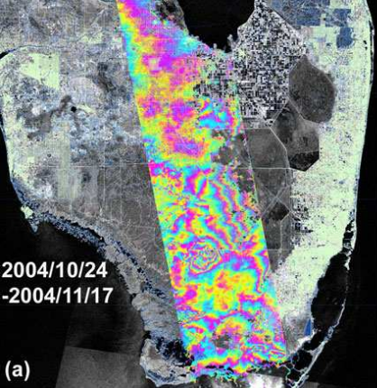
Schmidt and Burgmann (2003)
Pritchard and Simons (2004)
Wdowinski et al (2006)
Notes:
Some other applications of InSAR. On the left is a map of the western margin of South America (Peru and Chile) showing four major subduction zone earthquakes, plus the deformation associated with four active volcanoes in the Andes (some moving up, some moving down, depending on the details of the magmatic systems feeding the volcanoes).
Top right shows the cumulative displacement from analysis of multiple interferograms covering the Santa Clara Valley (northwest of San Jose in northern California) over a six-year period showing that the center of the valley rose by approximately 40 mm over that time, attributed to recharge of a major groundwater aquifer in the valley.
Bottom right shows the difference in water levels within the Everglades in south Florida between two dates in Fall 2004.
Image sources (clockwise from left):
Pritchard, M. E. and M. Simons (2004) Surveying volcanic arcs with satellite radar interferometry: The central Andes, Kamchatka, and beyond. GSA Today 14, 4-10. http://www.geo.cornell.edu/eas/PeoplePlaces/Faculty/matt/gsatv14n8_science.pdf Geological Society of America allows reuse of a single figure from an article for education noncommerical purposes. Copyright is retained by GSA. http://www.geosociety.org/pubs/copyrt.htm
Schmidt, D. and R. Bürgmann (2003) Time-dependent land uplift and subsidence in the Santa Clara valley, California, from a large interferometric synthetic aperture radar data set. Journal of Geophyical Research Solid Earth, 108, B9, DOI: 10.1029/2002JB002267. http://onlinelibrary.wiley.com/doi/10.1029/2002JB002267/epdf American Geophysical Union allows reuse of an image from a journal article for educational noncommercial purposes. Copyright is retained by AGU. http://publications.agu.org/author-resource-center/usage-permissions/
Wdowinski, S., S. Kim, F. Amelung, and T. Dixon (2006) Wetland InSAR: A new space-based hydrological monitoring tool of wetlands surface water level changes, GlobWetland Symposium proceedings. https://www.rsmas.miami.edu/users/swdowinski/publications/Wdowinski-GlobWetlands-proceedings.pdf GlobWetlands Symposium is part of the open CGIAR. https://cgspace.cgiar.org/

Slide 15
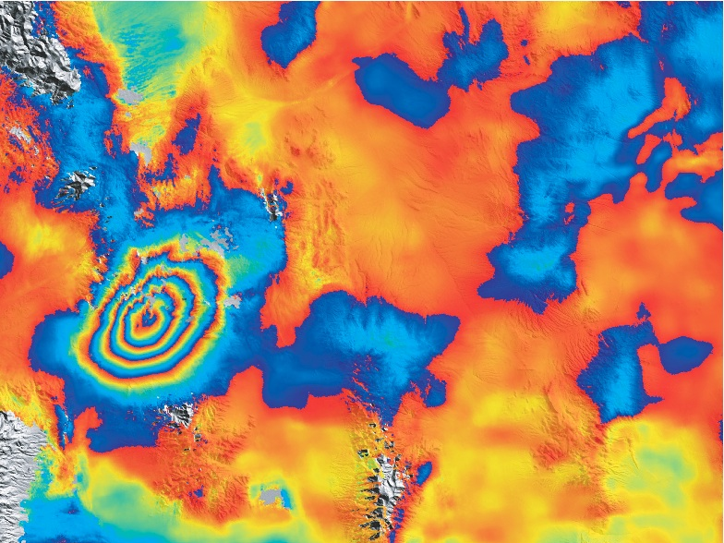
2008 Wells, Nevada
Each cycle of
blue => yellow => red
= 28 mm of displacement
(half of the radar wavelength)
away from the satellite
10 km
Notes:
Here is another earthquake interferogram, from the 2008 Wells, Nevada earthquake. In this case, each cycle of blue to yellow to red represents an increase in distance (a range increase) of 28 mm between the satellite and the ground. [Note that there is no standard convention for the color scheme of interferograms!]
The earthquake is represented by four concentric fringes. The whole pattern is about 10 km long and 8 km wide. Assuming that all of the line-of-sight deformation in this case represents vertical deformation, the four fringes represent a maximum of about 12 cm of subsidence of the surface, at the center of the pattern. One way of visualizing this is to imagine it raining after the earthquake. If the depression caused by the earthquake filled in with water, you would have a puddle 10 km long by 8 km wide, and 12 cm deep in the middle. If you visited the area after the earthquake, what are the chances you would recognize that as being the signature of an earthquake on the ground? → there would most likely NOT be any evidence from the surface because it is 10-12cm of change across 10 km wide area
Was there a surface rupture?
→ No. We can not see any discontinuities that are associated with with quake so no surface rupture

Slide 16
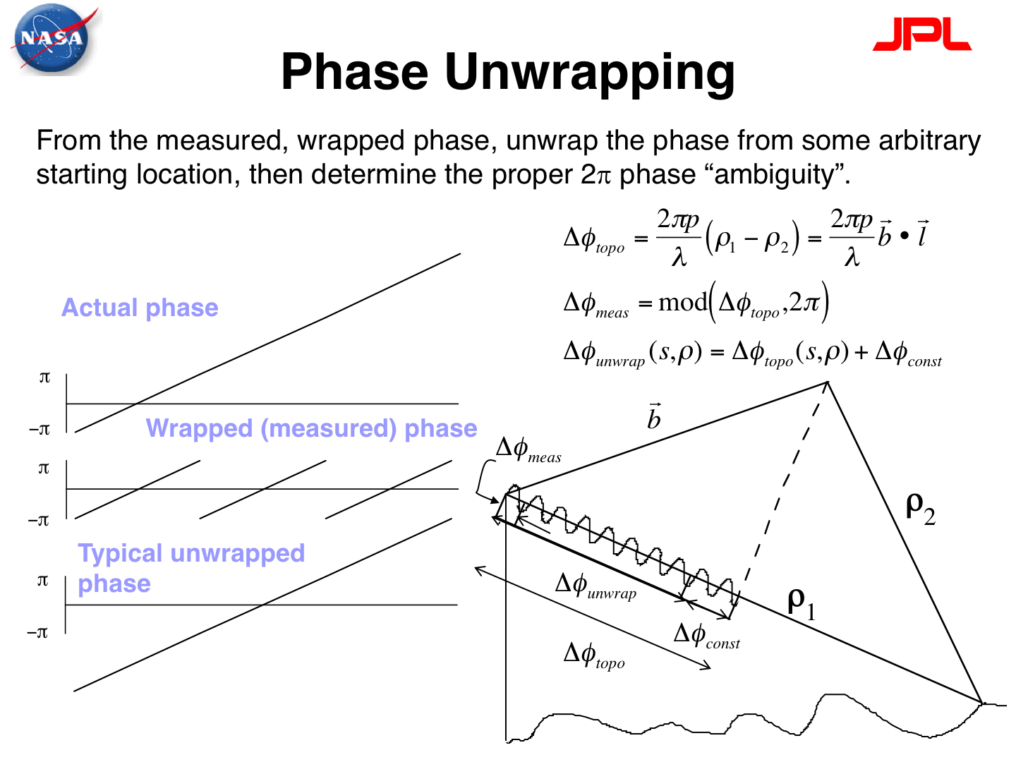

Slide 17
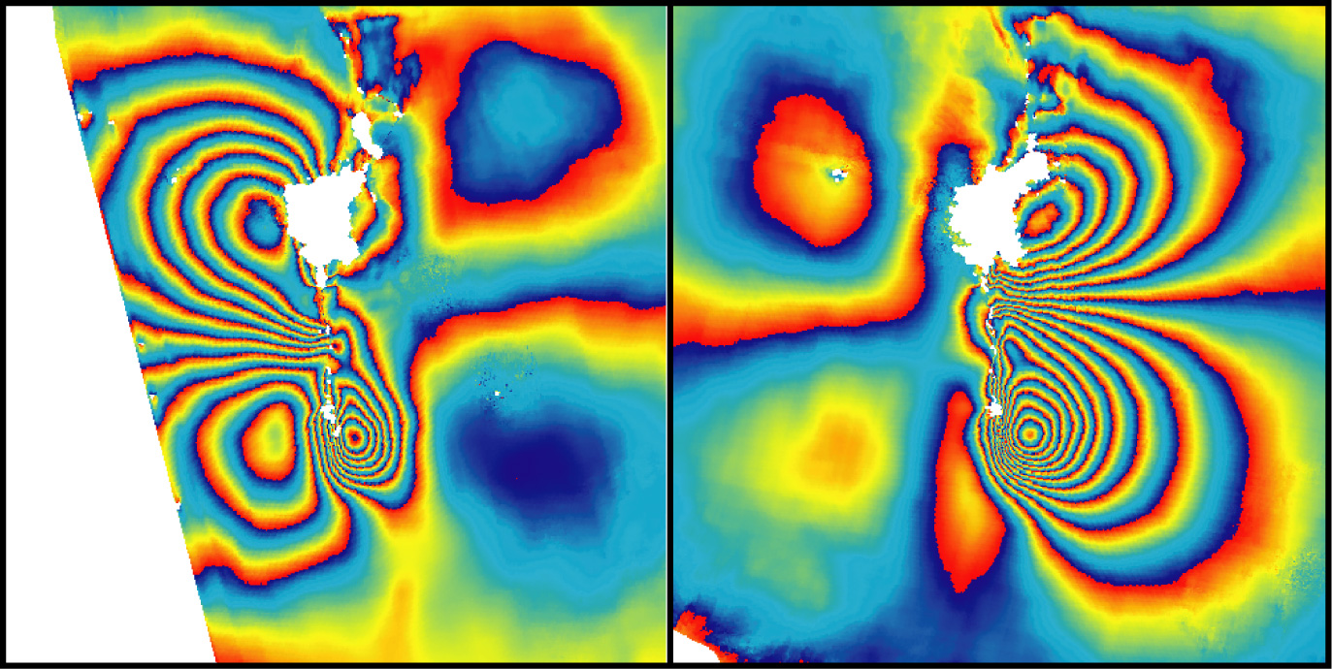
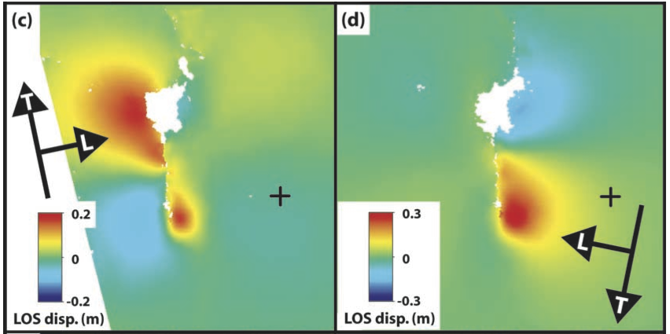
“wrapped”
“unwrapped”
Notes:
Here is an interferogram of a strike-slip earthquake (Bam, Iran, 2003), presented two different ways. On the left is the “wrapped” interferogram, which is the form we have seen several times already, with multiple fringes defining the deformation pattern (here blue-yellow-red is a motion toward the satellite of 28 mm). On the right is an “unwrapped” interferogram where the displacements associated with each fringe have been added together to give the total displacement—these are typically easier to interpret than the wrapped interferograms (again, here, red indicates movement toward the satellite, blue indicates movement away from the satellite).
Image source: G J Funning, B Parsons, T J Wright, J A Jackson and E J Fielding, 2005, Surface displacements and source parameters of the 2003 Bam, Iran earthquake from Envisat Advanced Synthetic Aperture Radar imagery, J. Geophys. Res., 110 (B9), B09406, doi:10.1029/2004JB003338.
http://earthsciences.ucr.edu/docs/funning_etal_2005_jgr_bam_earthquake.pdf
American Geophysical Union allows reuse of an image from a journal article for educational noncommercial purposes. Copyright is retained by AGU.
http://publications.agu.org/author-resource-center/usage-permissions/

Slide 18
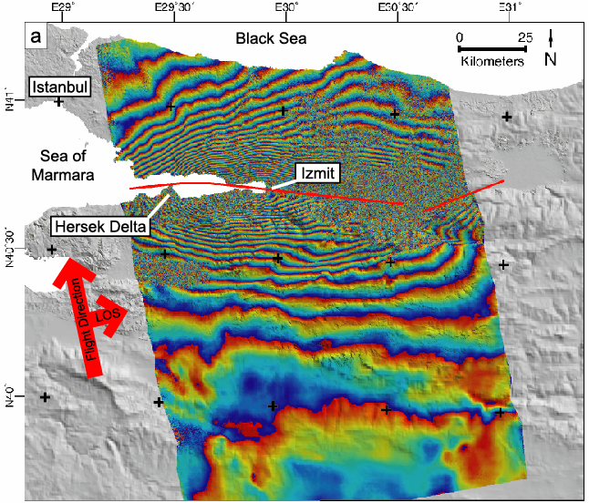
(-20) 567 mm range decrease
(-10) 283 mm range decrease
(-2) 57 mm range decrease
(-1) 28 mm range decrease
(0) 0 mm range change
17 August 1999, Izmit earthquake (Turkey)
Tim Wright
Notes:
How to interpret an interferogram? To begin we have to be sure of the sign convention of the deformation signal. Here each colored “fringe” from blue to yellow to red represents a movement of the ground toward the satellite of 28.3 mm in the line-of-sight direction (this is often described as a decrease in the range—that is to say, the distance—between the satellite and the ground).
If we assume that the color boundary between red and blue farthest to the south represents zero deformation (say), then each successive fringe cycle from blue-yellow-red represents an increasing movement of the ground toward the satellite of 28.3 mm, just like contours of elevation on a topographic map.
The first fringe to the north of our zero fringe indicates a movement of 28.3 mm toward the satellite.
The second fringe to the north of our zero fringe indicates a movement of 56.6 mm toward the satellite.
The tenth fringe to the north of our zero fringe indicates a movement of 283 mm toward the satellite.
The 20th fringe to the north of our zero fringe indicates a movement of 566 mm towards the satellite.
And so on . . .
Given that the satellite was flying from south to north and looking to the east, the reductions in distance between satellite and ground are consistent with westward motion of the ground south of the fault.
Image source: Tim Wright (University of Leeds) – used with permission

Slide 19
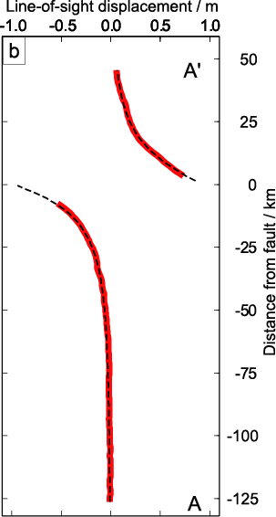
A’
A
17 August 1999, Izmit earthquake (Turkey)
Tim Wright
Notes:
If you plot a profile of the cumulative displacement represented by the fringes, you get a curve that looks something like this. Note that there is a discontinuity in the pattern in the center, around the city of Izmit; you have to repeat the analysis of the northern part of the deformation pattern separately, counting in from the edge of the deformation pattern like before. The shape of the curve is consistent with the expected elastic rebound from a strike-slip earthquake. The 1.2 m of line-of-sight displacement measured here corresponds to approximately 3.5 m of right-lateral offset.
Image source: Tim Wright (University of Leeds) – used with permission

Slide 20
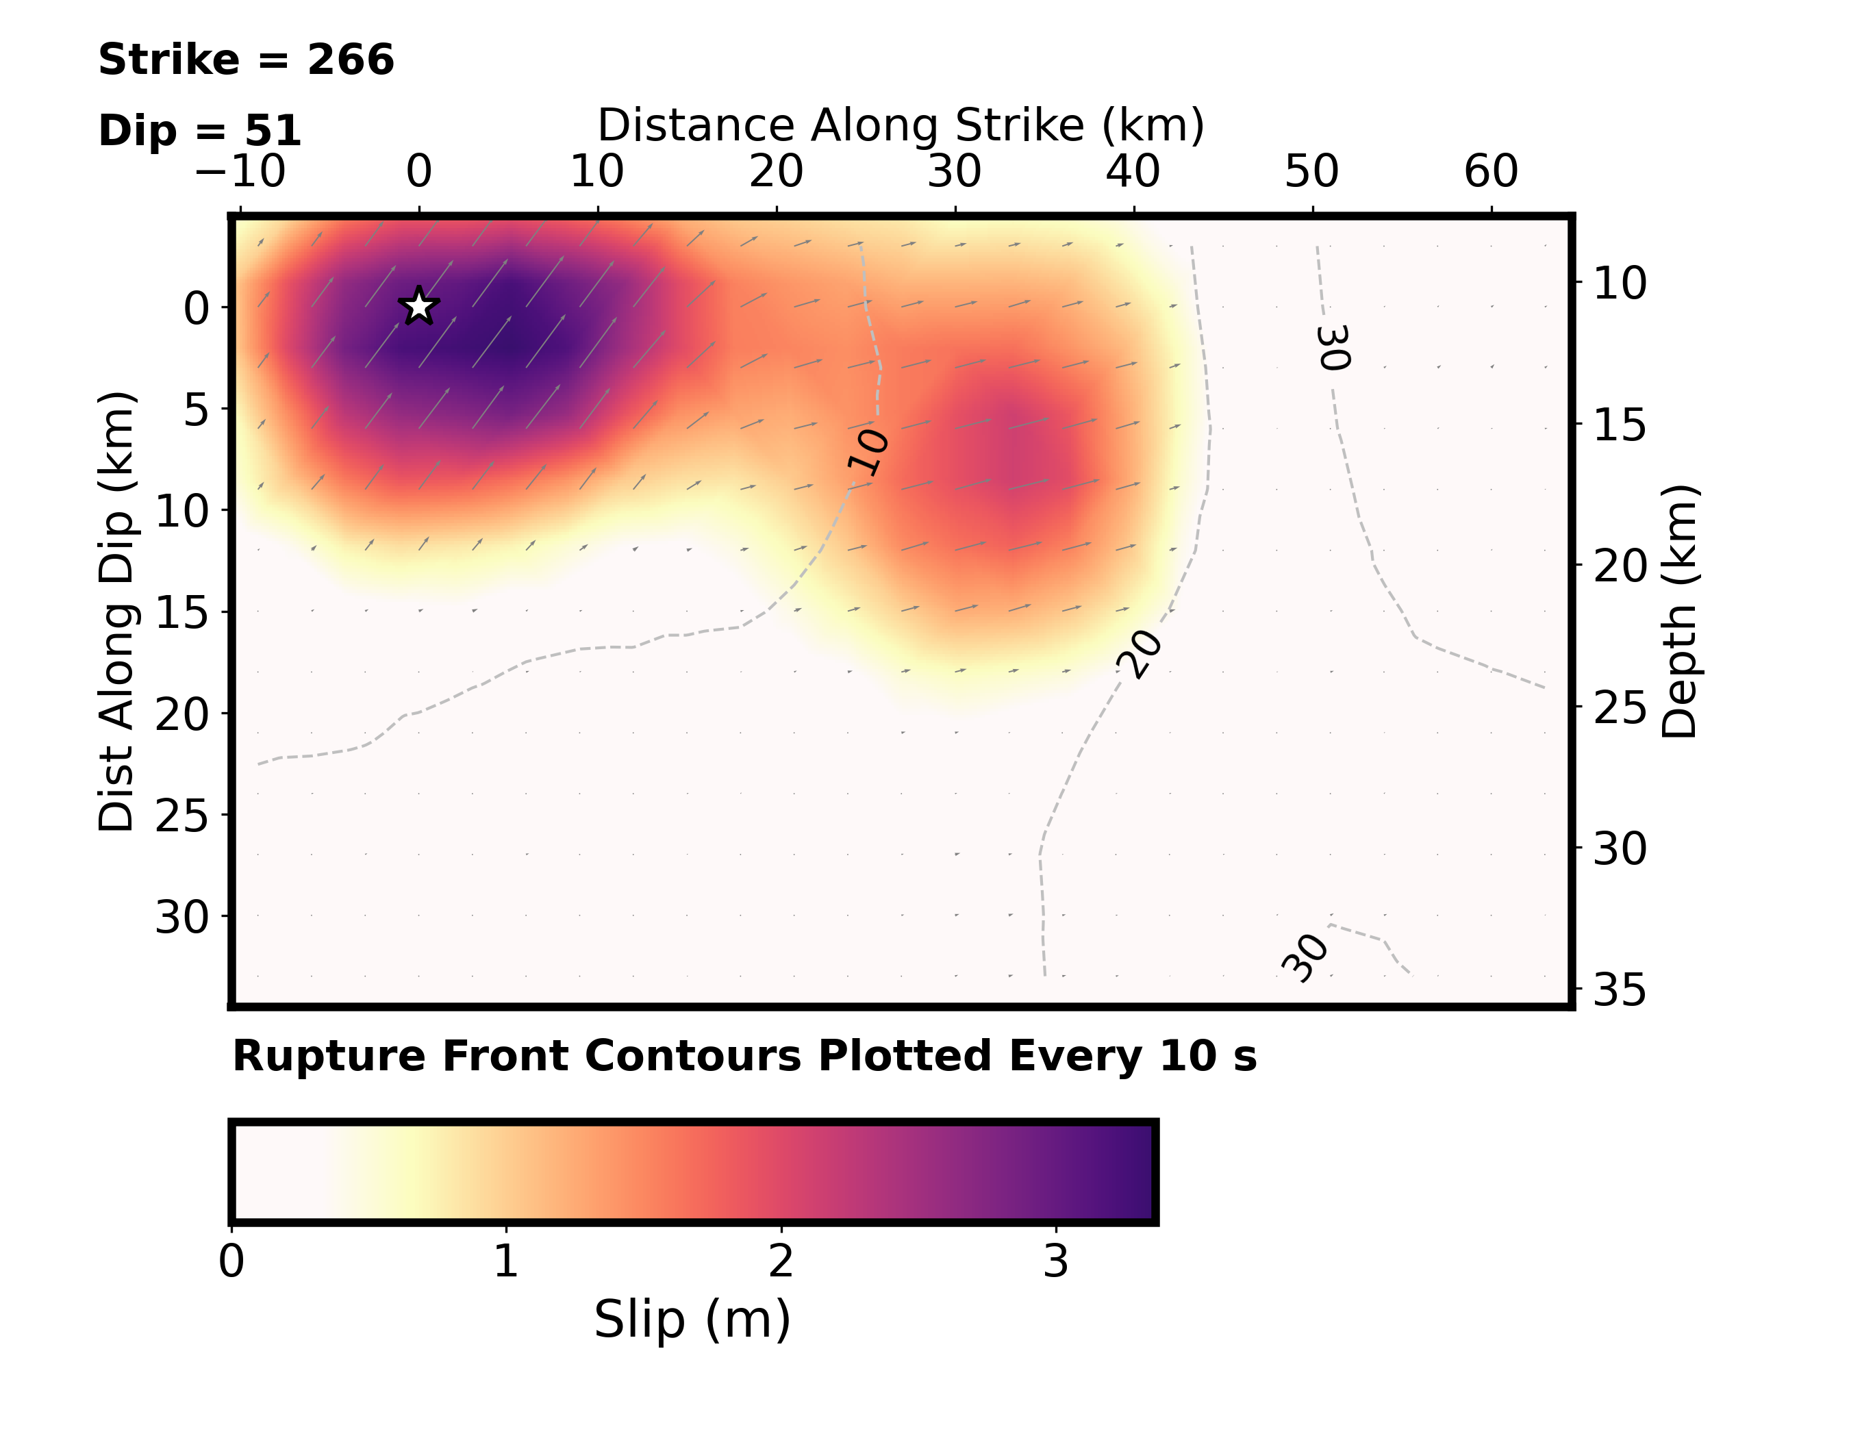
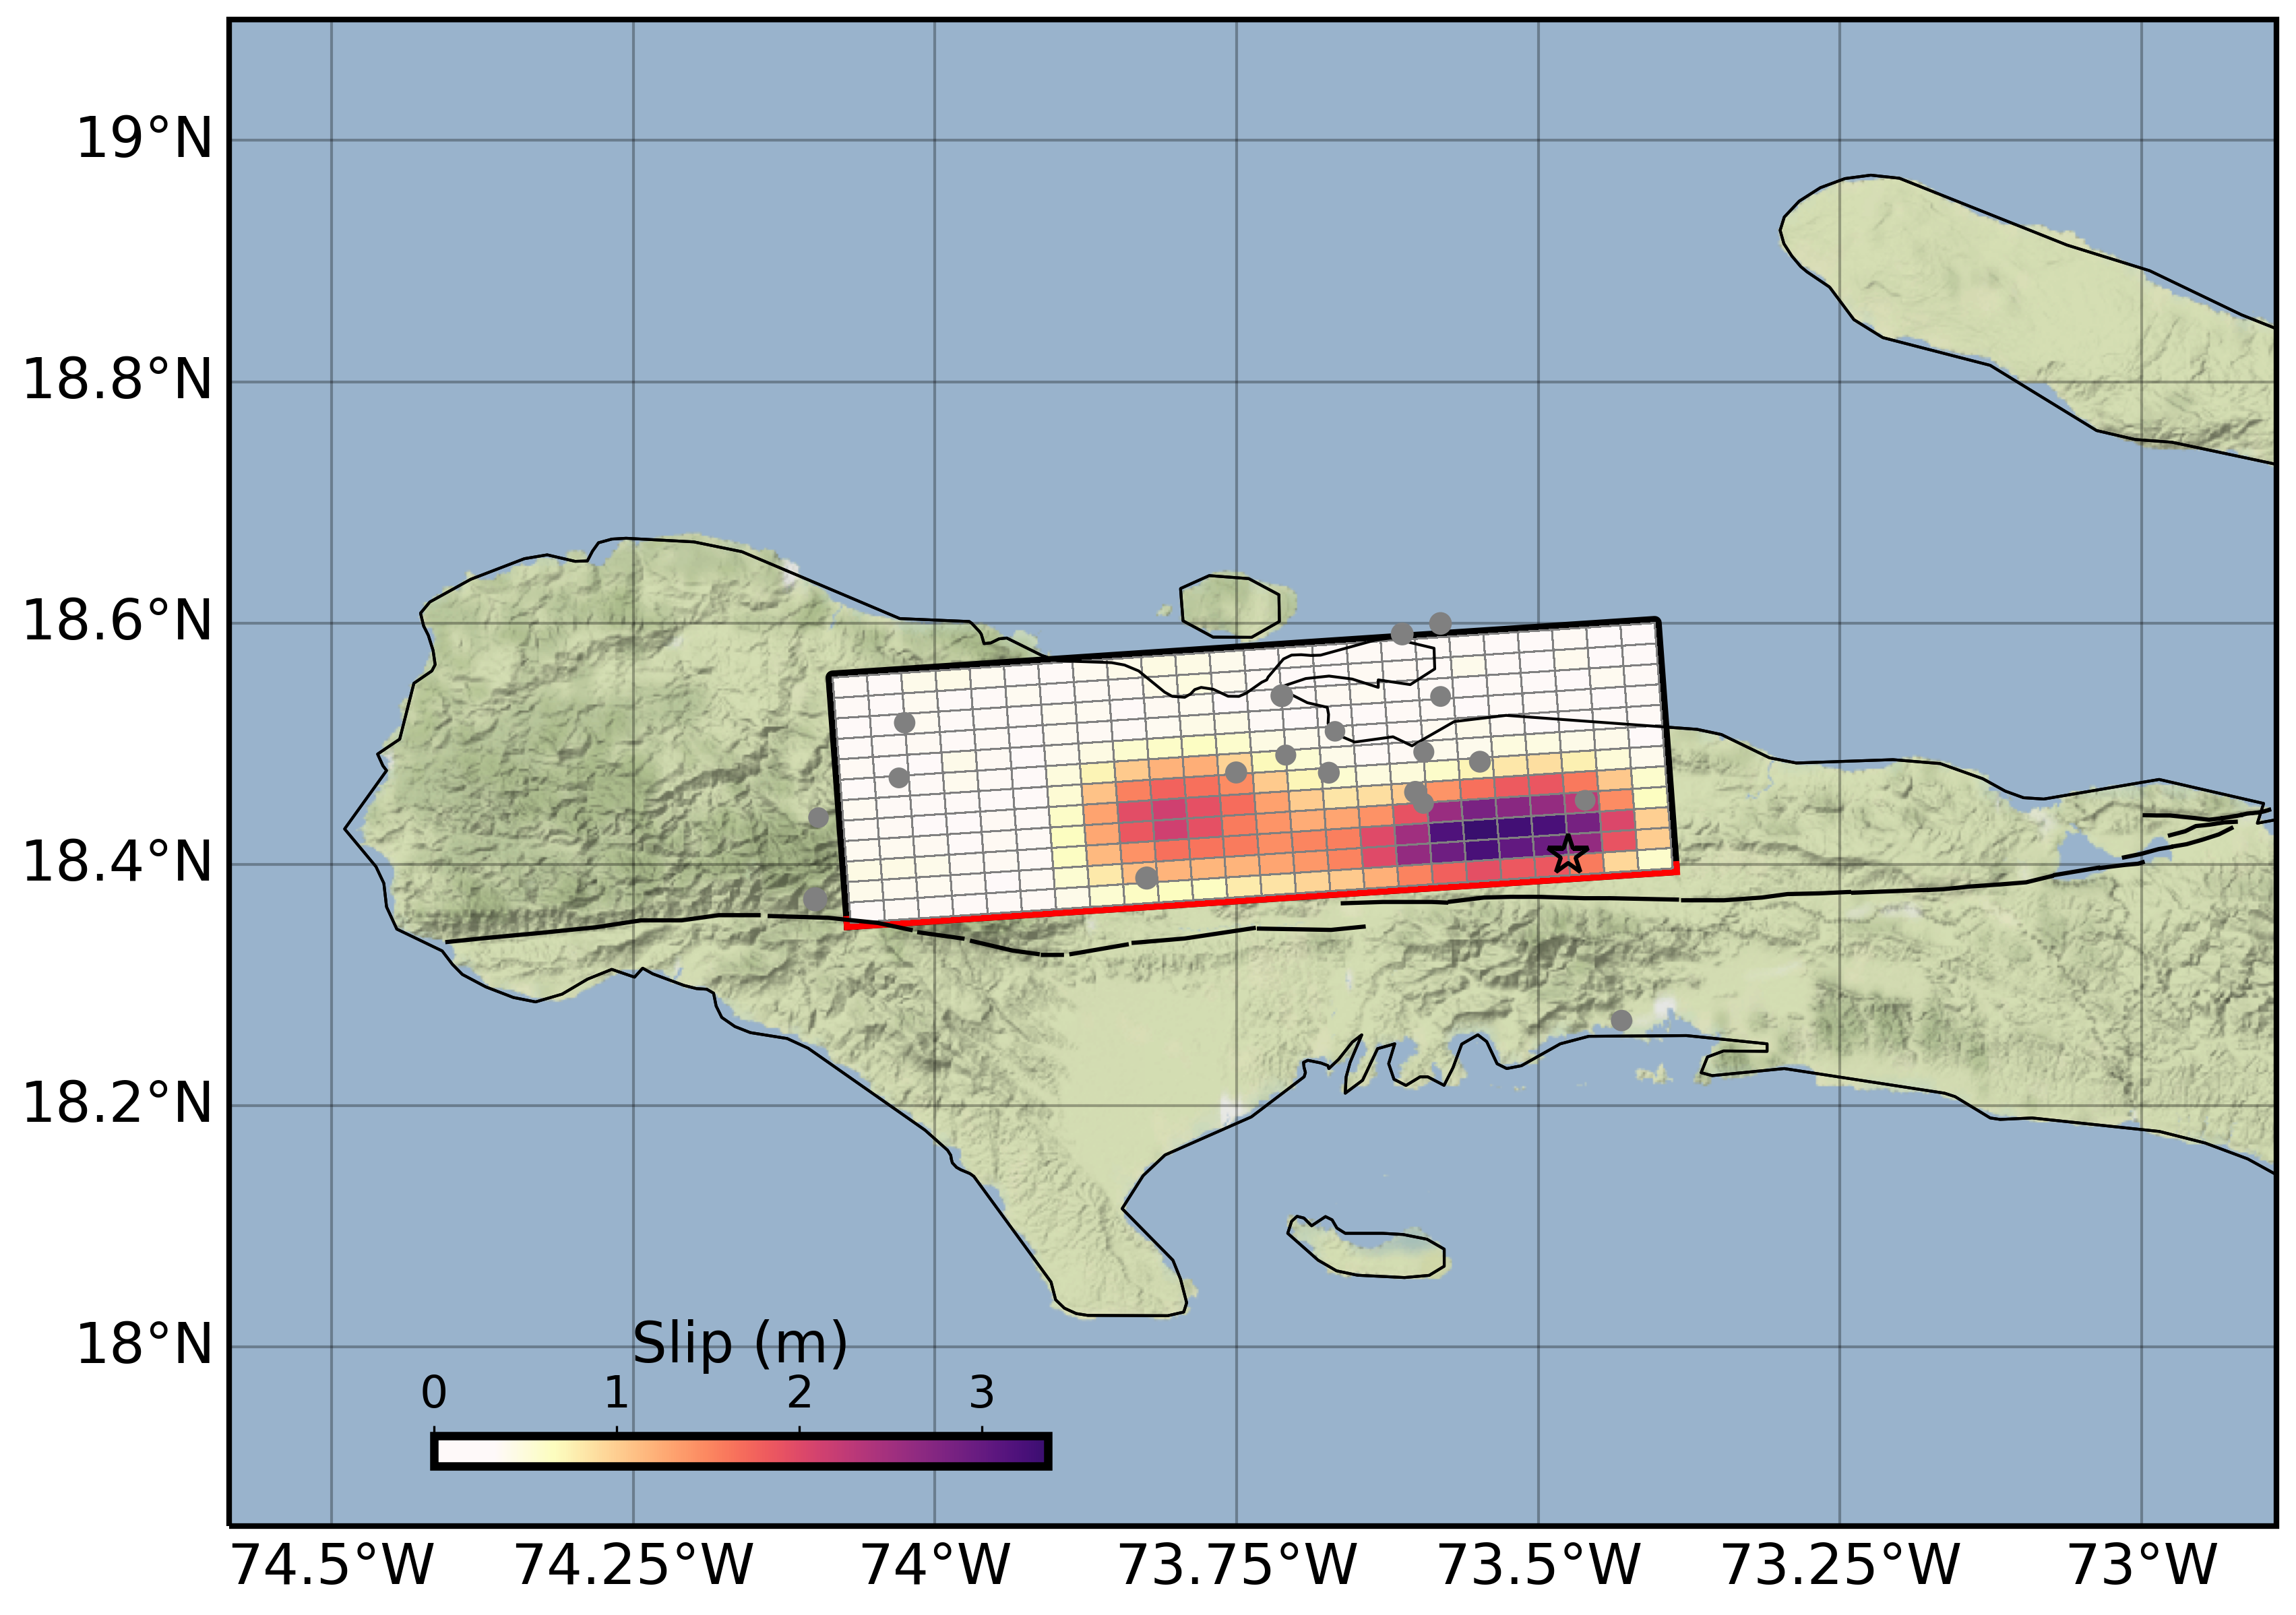
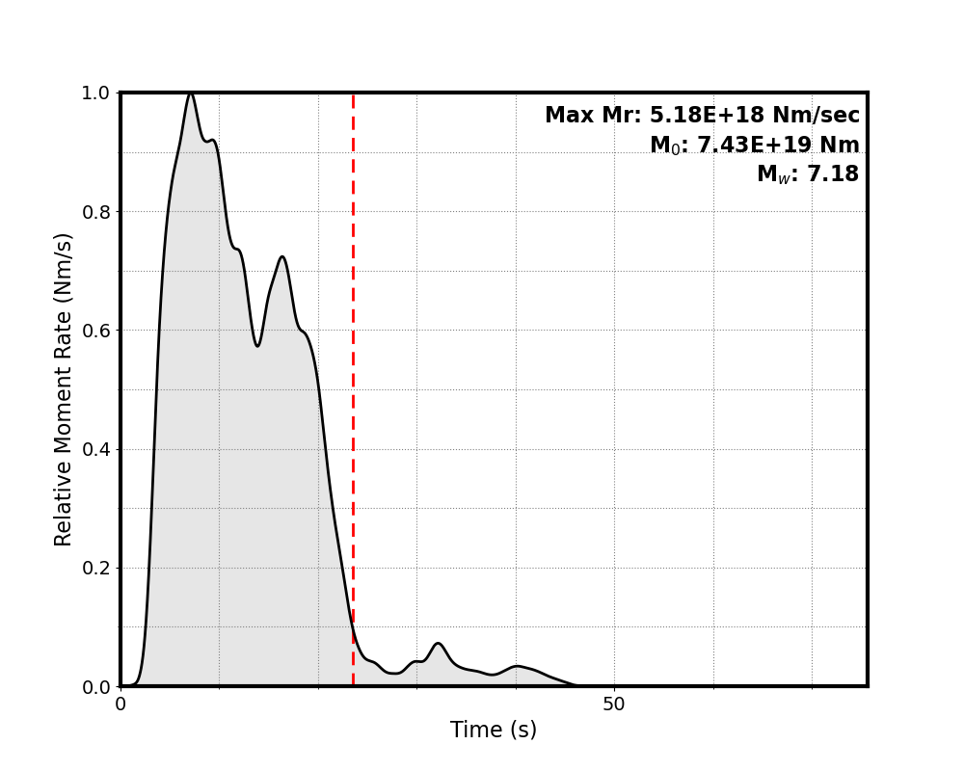
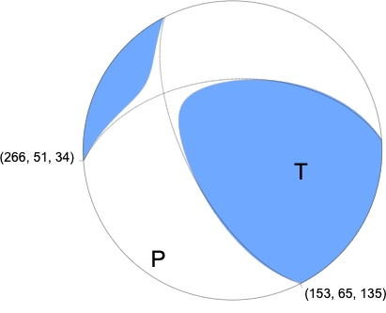
2021 Mw 7.2 Haiti Earthquake Seismic results from USGS
Seismic-only solution from USGS indicates oblique slip on a northward-dipping fault
earthquakes.usgs.gov

Slide 21
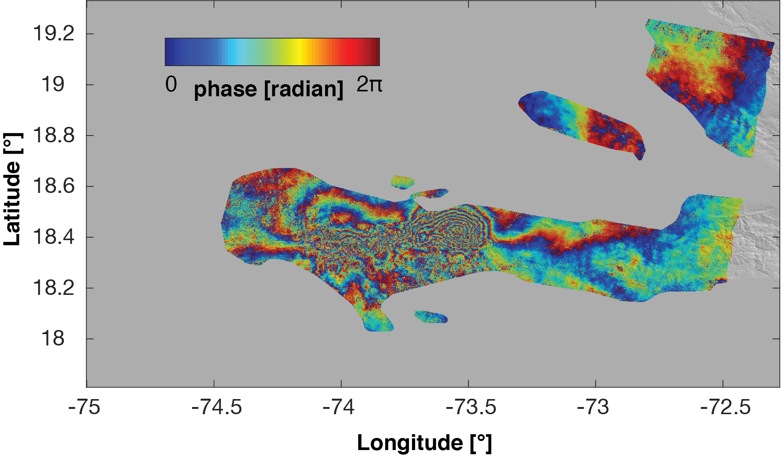
2021 Haiti Earthquake Enriquillo-Plaintain Garden Fault Zone
August 14, 2021
M_{W} 7.2
Devastating social consequences

Slide 22
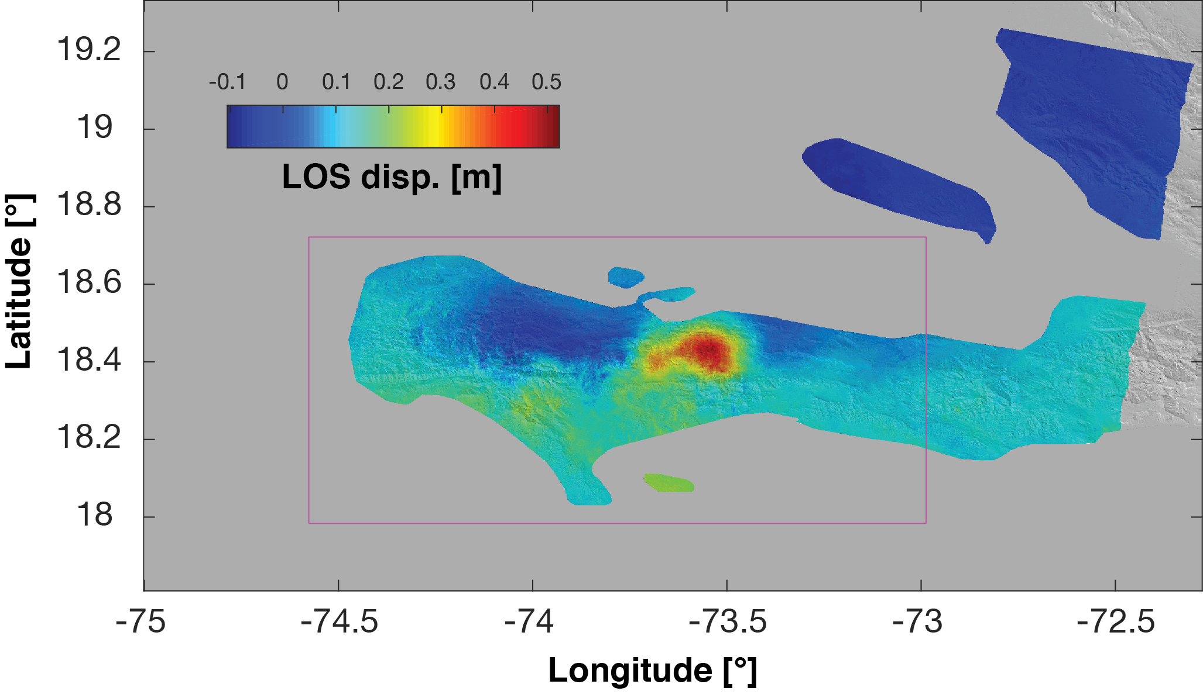
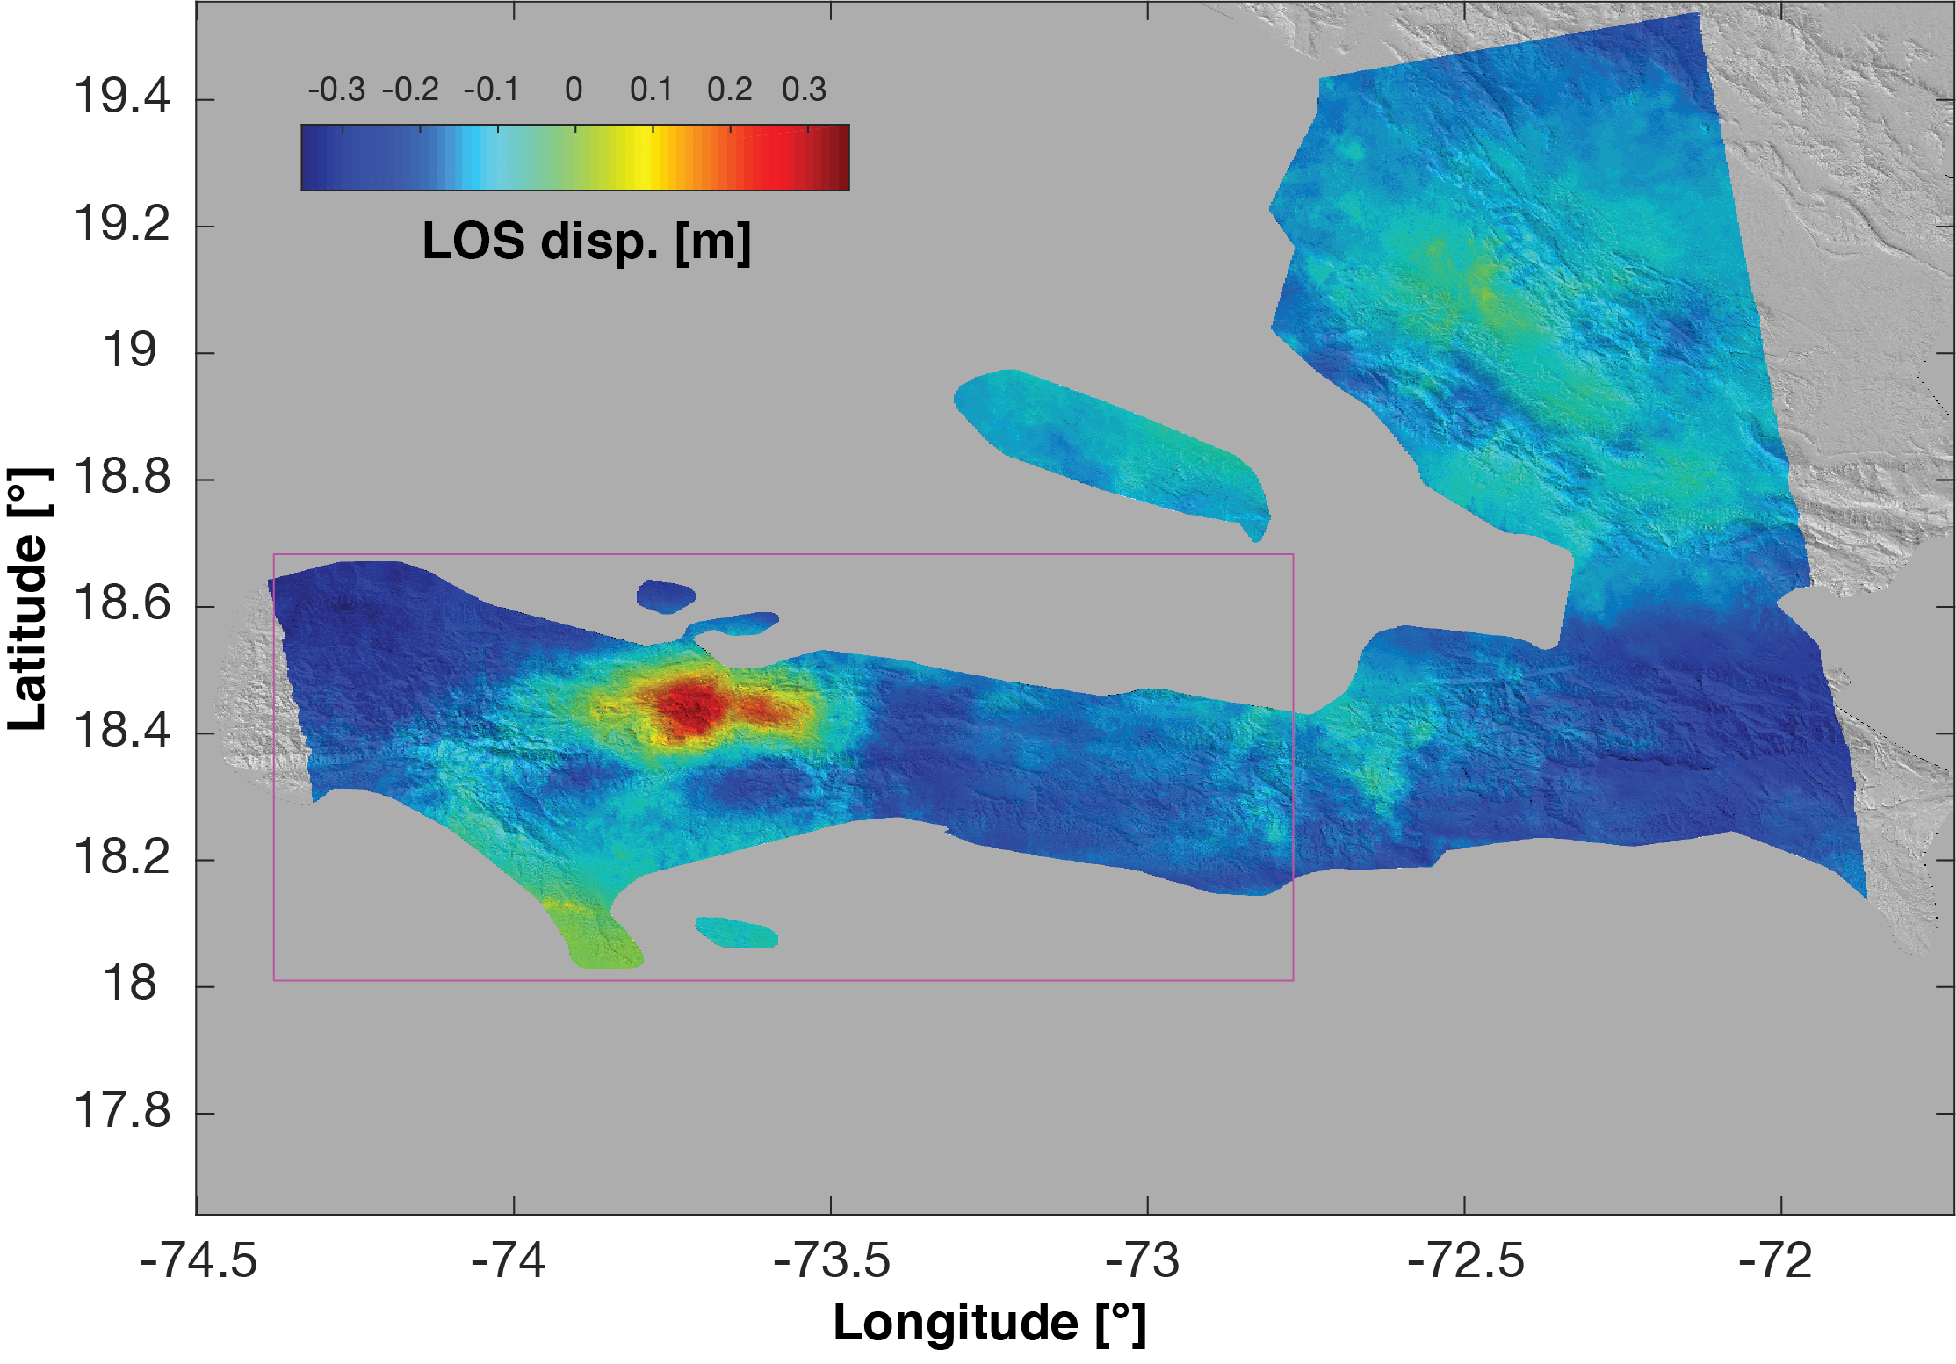
2021 Mw 7.2 Haiti Earthquake Preliminary InSAR results
Descending IFG: Aug 3 – Aug 15
Subsidence/LL
Uplift/RL
Descending track 142
Ascending IFG: Aug 5 – Aug 17
Subsidence/RL
Uplift/LL
Coseismic interferograms suggest oblique left-lateral slip
Ascending track 4

Slide 23
Benefits and Challenges of InSAR

Slide 24
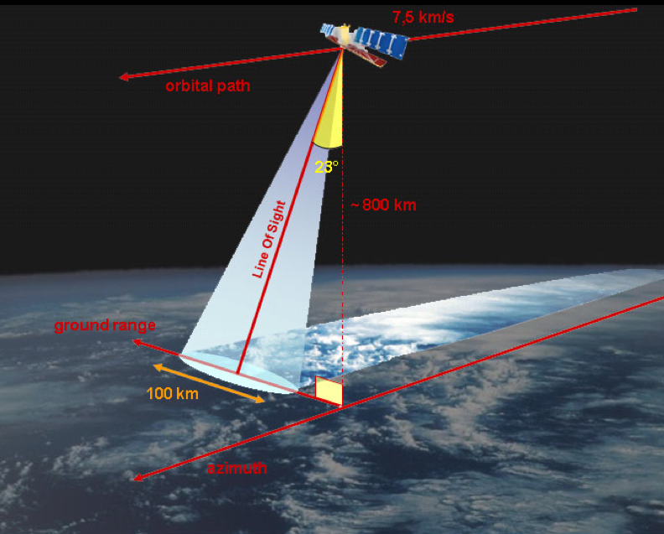
InSAR Provides Regular, Dense, and Global Observations of Crustal Deformation
Advantages
High resolution (~20 m for Sentinel-1, ~30 m for ALOS-2, variable for NISAR)
Large ground coverage
Repeat cycles (~ few weeks)
© TRE

Slide 25
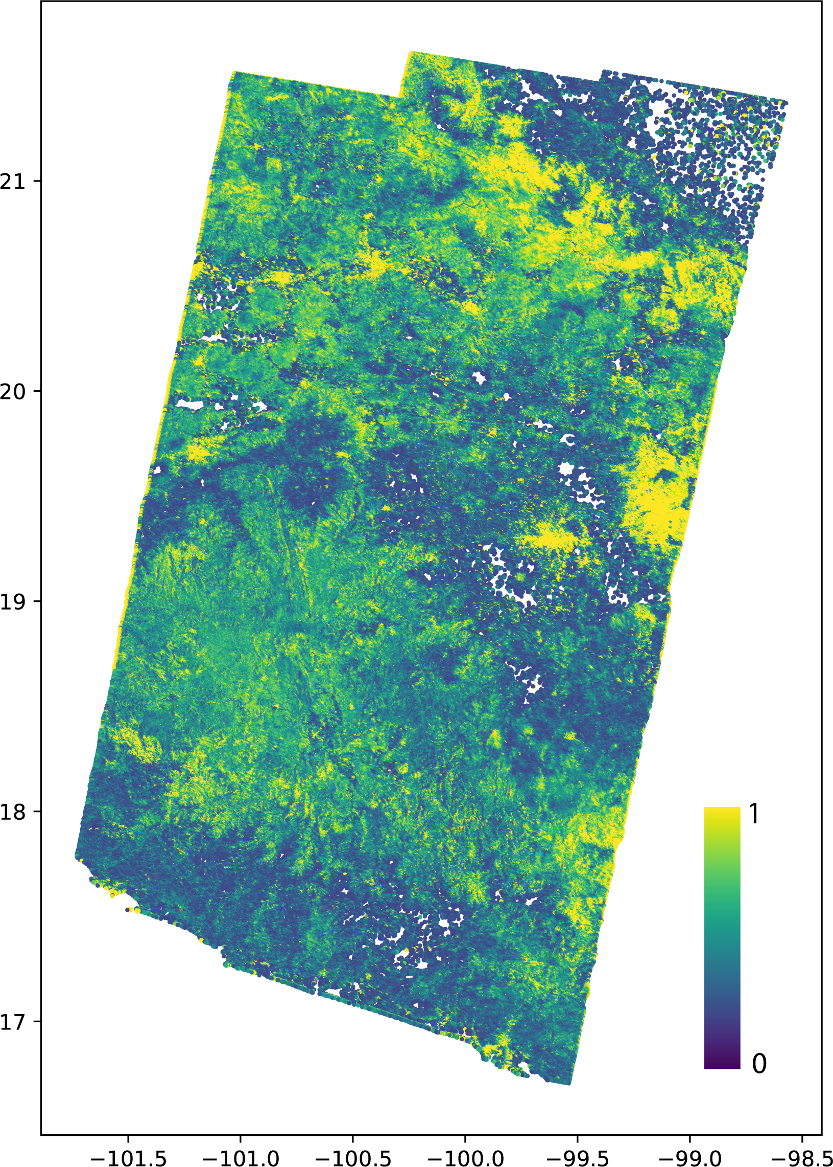
InSAR Provides Regular, Dense, and Global Observations of Crustal Deformation
Advantages
High resolution (~20 m for Sentinel-1, ~30 m for ALOS-2 , variable for NISAR)
Large ground coverage
Repeat cycles (~ few weeks)
Challenges (for tectonic deformation)
Noise
Interferometric image decorrelation related to change in surface properties over time, especially due to vegetation growth and snow

Slide 26
InSAR Provides Regular, Dense, and Global Observations of Crustal Deformation
Advantages
High resolution (~20 m for Sentinel-1, ~30 m for ALOS-2 , variable for NISAR)
Large ground coverage
Repeat cycles (~ few weeks)
Challenges (for tectonic deformation)
Noise
Interferometric image decorrelation related to change in surface properties over time, especially due to vegetation growth and snow
L-band radar reduces decorrelation due to vegetation
ALOS, upcoming NISAR

Slide 27
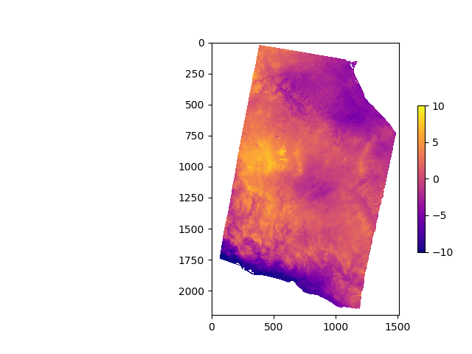
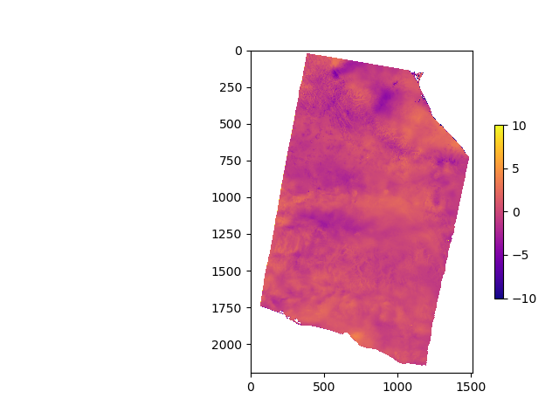
InSAR Provides Regular, Dense, and Global Observations of Crustal Deformation
Advantages
High resolution (~20 m for Sentinel-1, ~30 m for ALOS-2 , variable for NISAR)
Large ground coverage
Repeat cycles (~ few weeks)
Challenges (for tectonic deformation)
Noise
Interferometric image decorrelation related to change in surface properties over time
Atmospheric delays (troposphere, ionosphere) cause large apparent deformation signals.
Long-wavelength atmospheric noise has similar spatial scales and magnitudes as the SSEs in Mexico
L-band radar especially susceptible to ionosphere
Original IFG
Apparent deformation (rad)
ALOS-2 D153, 42-day pair

Slide 28
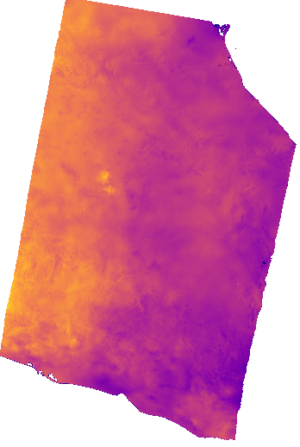
InSAR Provides Regular, Dense, and Global Observations of Crustal Deformation
Advantages
High resolution (~20 m for Sentinel-1, ~30 m for ALOS-2)
Large ground coverage
Repeat cycles (~ few weeks)
Challenges (for tectonic deformation)
Noise
Interferometric image decorrelation related to change in surface properties over time
Atmospheric delays (troposphere, ionosphere) cause large apparent deformation signals.
Long-wavelength atmospheric noise has similar spatial scales and magnitudes as the SSEs in Mexico
L-band radar especially susceptible to ionosphere
Original IFG
Corrected for Atmosphere
Apparent deformation (rad)
ALOS-2 D153, 42-day pair
Corrections for ionosphere, troposphere
Time-series analysis
Bekaert et al., 2015a JGR
Bekaert et al., 2015c RSE
Liang et al., 2018 IEEE

Slide 29
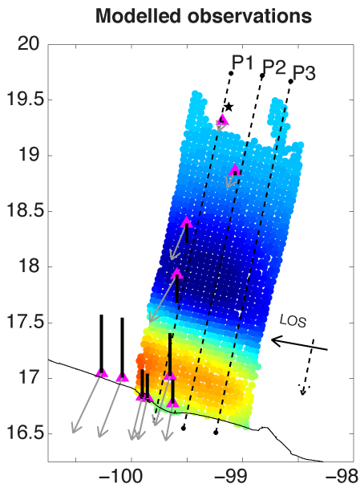
InSAR Provides Regular, Dense, and Global Observations of Crustal Deformation
Advantages
High resolution (~20 m for Sentinel-1, ~30 m for ALOS-2)
Large ground coverage
Repeat cycles (~ few weeks)
Challenges (for tectonic deformation)
Noise
Interferometric image decorrelation related to change in surface properties over time
Atmospheric delays (troposphere, ionosphere) cause large apparent deformation signals.
Residual troposphere causes large noise artifacts in the slip inversion
Variance-only
Bekaert et al., 2015a JGR

Slide 30
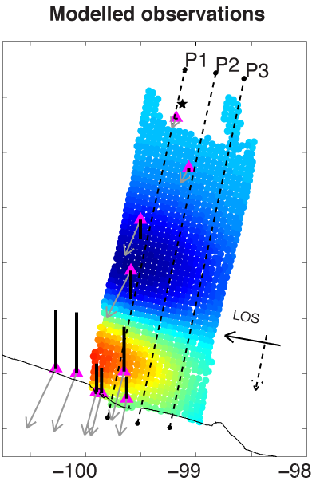
InSAR Provides Regular, Dense, and Global Observations of Crustal Deformation
Advantages
High resolution (~20 m for Sentinel-1, ~30 m for ALOS-2)
Large ground coverage
Repeat cycles (~ few weeks)
Challenges (for tectonic deformation)
Noise
Interferometric image decorrelation related to change in surface properties over time
Atmospheric delays (troposphere, ionosphere) cause large apparent deformation signals.
Residual troposphere causes large noise artifacts in the slip inversion
Variance-only
Full Covariance
Bekaert et al., 2015a JGR
Use full covariance in inversion
Account for uncertainties using Bayesian methods

Slide 31
Atmospheric Corrections for InSAR
Or, if only the earth had no air…

Slide 32
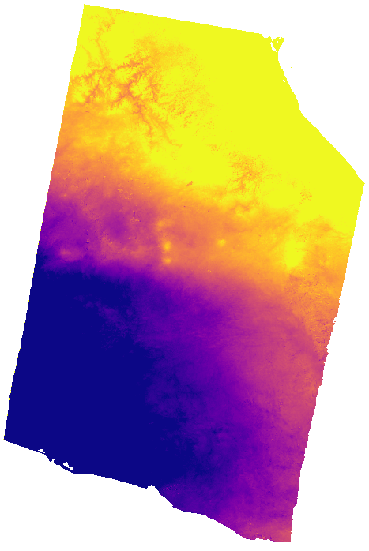
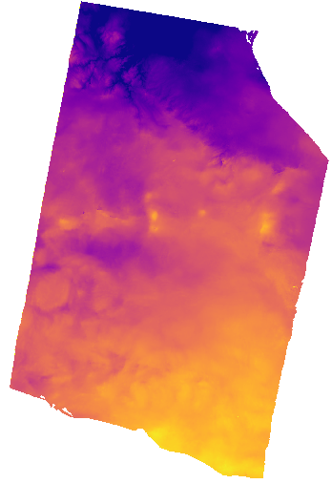
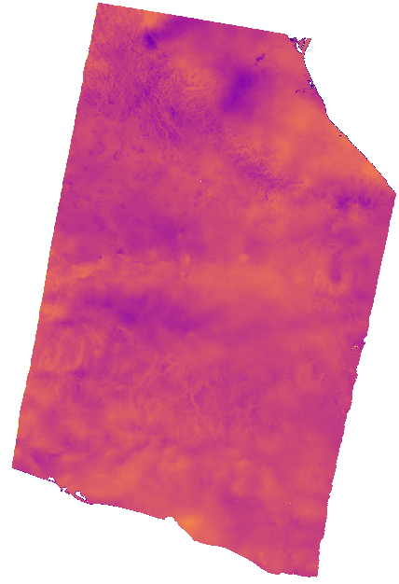
Ionospheric and Tropospheric corrections can significantly lower noise in individual IFGs
We estimate and remove ionosphere using the method of Liang et al., 2018
We remove troposphere using total delays from GACOS (Yu et al., 2018) and TRAIN (Bekaert et al., 2015)
Unwrapped IFG, uncorrected
Corrected for Ionosphere
Corrected for Troposphere
Apparent displacement (rad)
Apparent displacement (rad)
Apparent displacement (rad)
NISAR will have ionosphere correction from dual-band system and a placeholder for troposphere correction
ALOS-2 D153

Slide 33
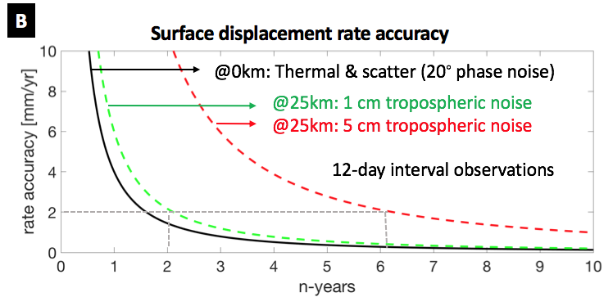
InSAR Provides Regular, Dense, and Global Observations of Crustal Deformation
Advantages
High resolution (~20 m for Sentinel-1, ~30 m for ALOS-2)
Large ground coverage
Repeat cycles (~ few weeks)
Challenges (for tectonic deformation)
Noise
Interferometric image decorrelation related to change in surface properties over time
Atmospheric delays (troposphere, ionosphere) cause large apparent deformation signals.
Long-wavelength atmospheric noise has similar spatial scales and magnitudes as the SSEs in Mexico
David Bekaert
Corrections for ionosphere, troposphere
Time-series analysis

Slide 34
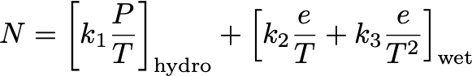
Ionosphere is dispersive
Tropospheric delays can be estimated from weather model data
The troposphere (not dispersive) is mainly described by isolines of
Temperature (T)
Pressure (P)
Water vapor (e)
P/T/e come from a weather model
isolines
David Bekaert

Slide 35
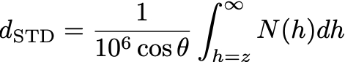
Tropospheric delays can be estimated from weather model data
The troposphere is mainly described by isolines of
Temperature (T)
Pressure (P)
Water vapor (e)
P/T/e come from a weather model
The tropospheric radar delay can be computed by integrating the refractivity N with height and projecting to the slant
isolines
David Bekaert

Slide 36
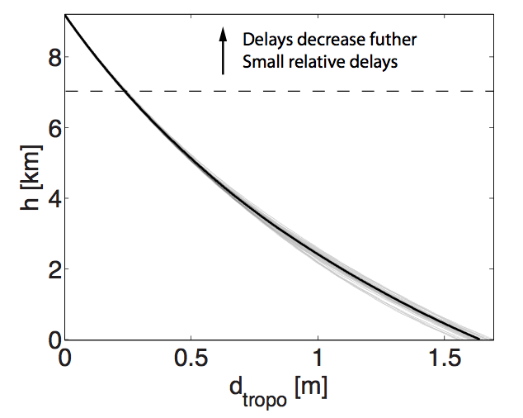
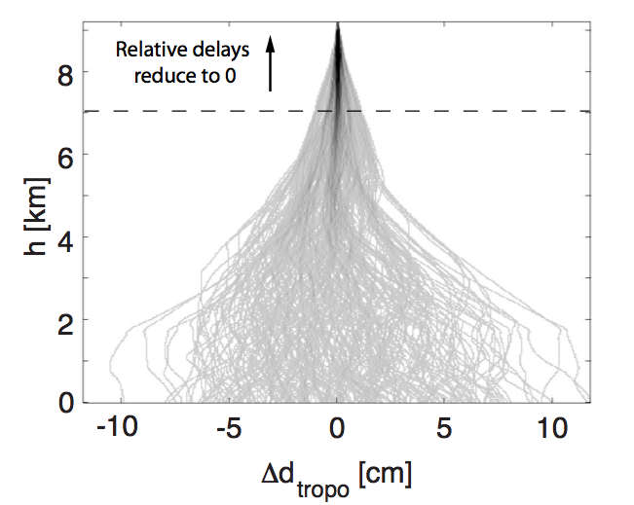
What drives the InSAR tropospheric signal?
Absolute delays dominated by d_{hydro}
Interferometric delays dominated by d_{wet}
Pressure/Temperature variations
Water vapor variations
Bekaert et al., JGR 2015
Modified from David Bekaert

Slide 37
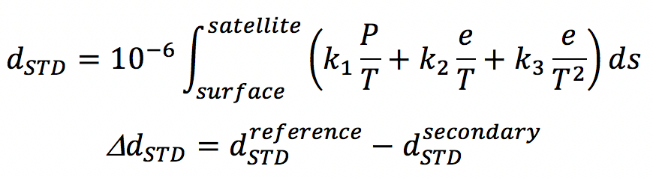
Current work focused on integrating delays in the slant direction
The troposphere is mainly described by isolines of
Temperature (T)
Pressure (P)
Water vapor (e)
The tropospheric radar delay can be computed by integrating the refractivity N along the ray travel path
isolines
David Bekaert

Slide 38
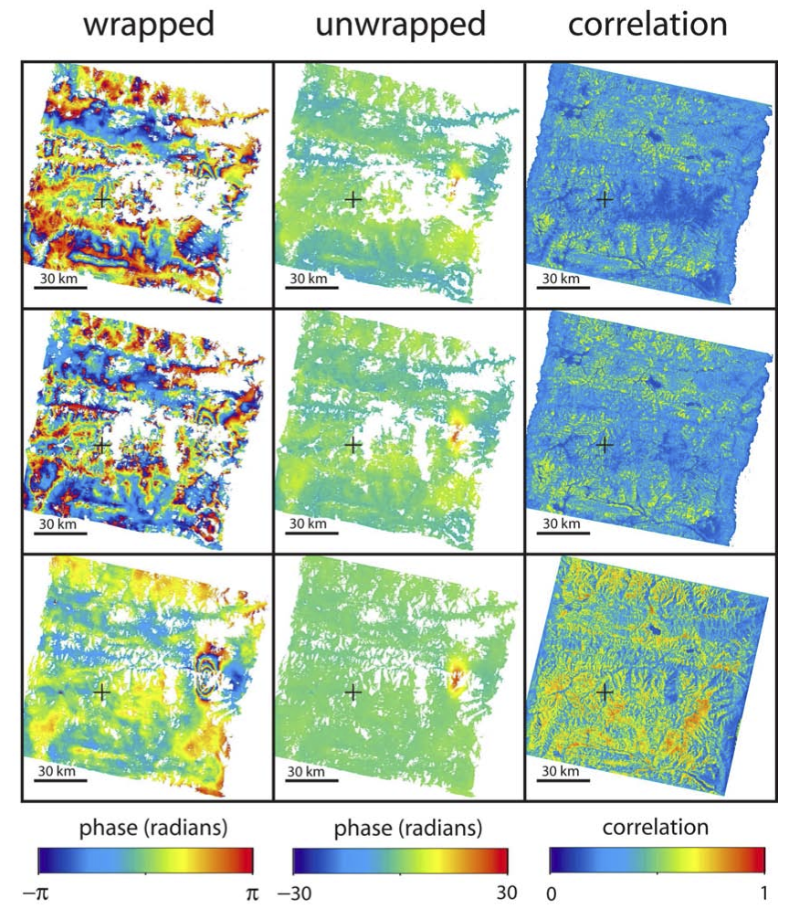
July 1992–March 1993
February 1993–March 1993
Atmosphere!
Snow!
Notes:
Here is another problem with InSAR: decorrelation. InSAR only works if the characteristics of the ground surface do not change between the two image acquisitions, so that when you subtract the phase of one image from another, you only see changes in distance between the satellite and the ground. If the ground is changed in some way (e.g. by growing vegetation, or by covering the ground in snow), then there will be a change to the phase that is not due to movement in the ground, and you lose signal.
On the left is an interferogram of a small earthquake in Tibet. The interferogram is noisy (there is some atmospheric water vapor signal in it), but the earthquake can be seen in the east. On the right is an interferogram of the same place, but covering a slightly different timespan. From this data it is very difficult to make out where the earthquake was from; the reason is that there was snow on the ground on the first image, which caused a loss of signal in the interferogram (an effect known as decorrelation).
Data from European Space Agency and processed by Gareth Funning

Slide 39
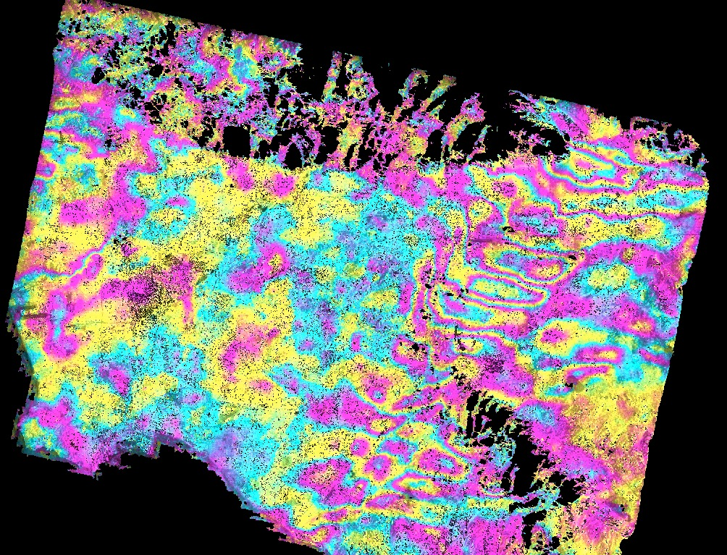
Los Angeles
time span = 1 day
Notes:
This slide illustrates one of the problems we sometimes have with InSAR—the behavior of the atmosphere.
This interferogram was made from images acquired one day apart (part of the so-called “tandem” mission of the ERS-1 and ERS-2 satellites in 1995-96). There was no earthquake on that day. And yet there are fringes everywhere! It turns out that these represent differences in the atmosphere between the two SAR image acquisitions that went into making the interferogram, and not actual deformation of the ground. The presence of water vapor in the troposphere (the part of the atmosphere that is closest to the ground) can refract radar waves and generate these atmospheric signals, particularly when one of the images is acquired on a day when the atmosphere was particularly turbulent.
Data from European Space Agency and processed by Gareth Funning

Slide 40
Atmospheric “noise”
Refraction of microwaves by water vapor
“Static” part can resemble topography
“Turbulent” part can resemble deformation
Decorrelation
Changes in radar scattering properties of pixels
Vegetation, snow, flooding, the passing of time…
Longer radar wavelengths less susceptible
Notes:
Both the noise generated by the atmosphere and decorrelation caused by changes to the ground are problematic for InSAR. In the former case, the deformation signal we are interested in can be overprinted (i.e. changed) by something that is not deformation, potentially giving an incorrect estimate of the deformation, or even hiding it entirely (especially if the signal we are looking for is small). In the latter case, we may not get any signal at all, which is even worse!
Luckily, we can design satellite missions so that decorrelation can be reduced, either by using a longer radar wavelength (which makes the radar phase less sensitive to changes in general), or by reducing the amount of time between acquisitions (which reduces the probability that the ground surface will change significantly). Efforts to use weather data and/or GPS data to correct for atmospheric noise are currently being developed and show some promise.

Slide 41
InSAR Time-series

Slide 42
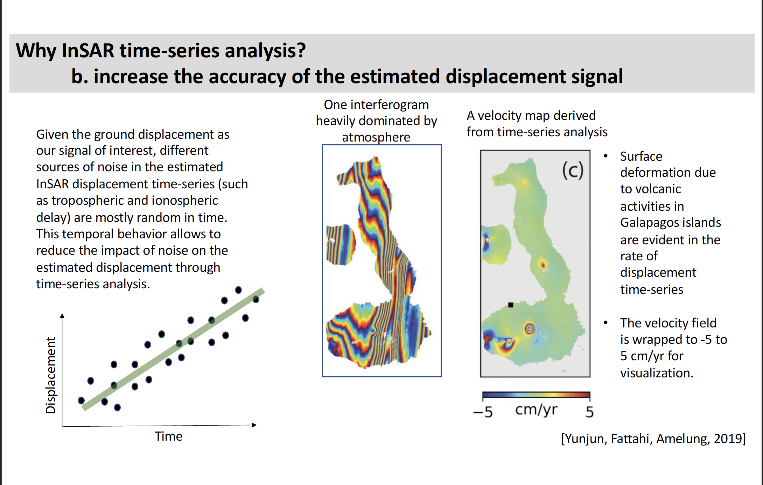

Slide 43
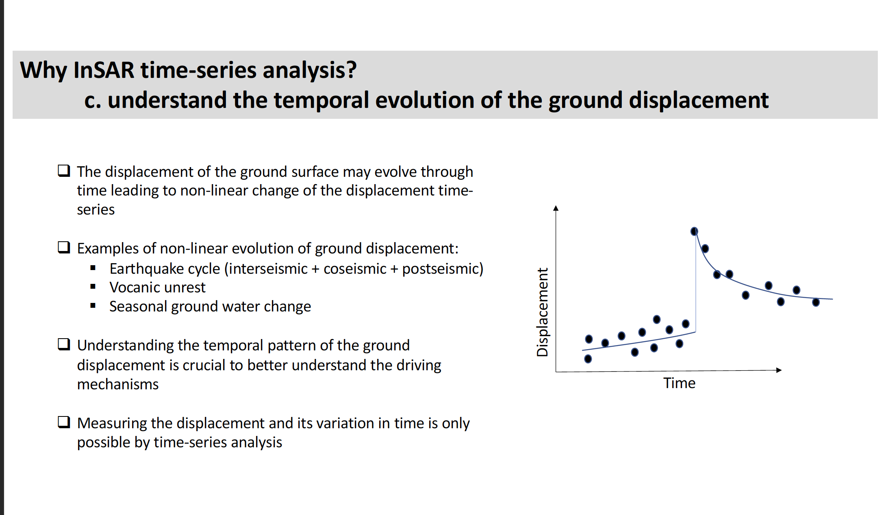

Slide 44
How to go from InSAR interferogram to time-series?

Slide 45
Cumulative displacements from individual interferograms
Displacement
Time

Slide 46
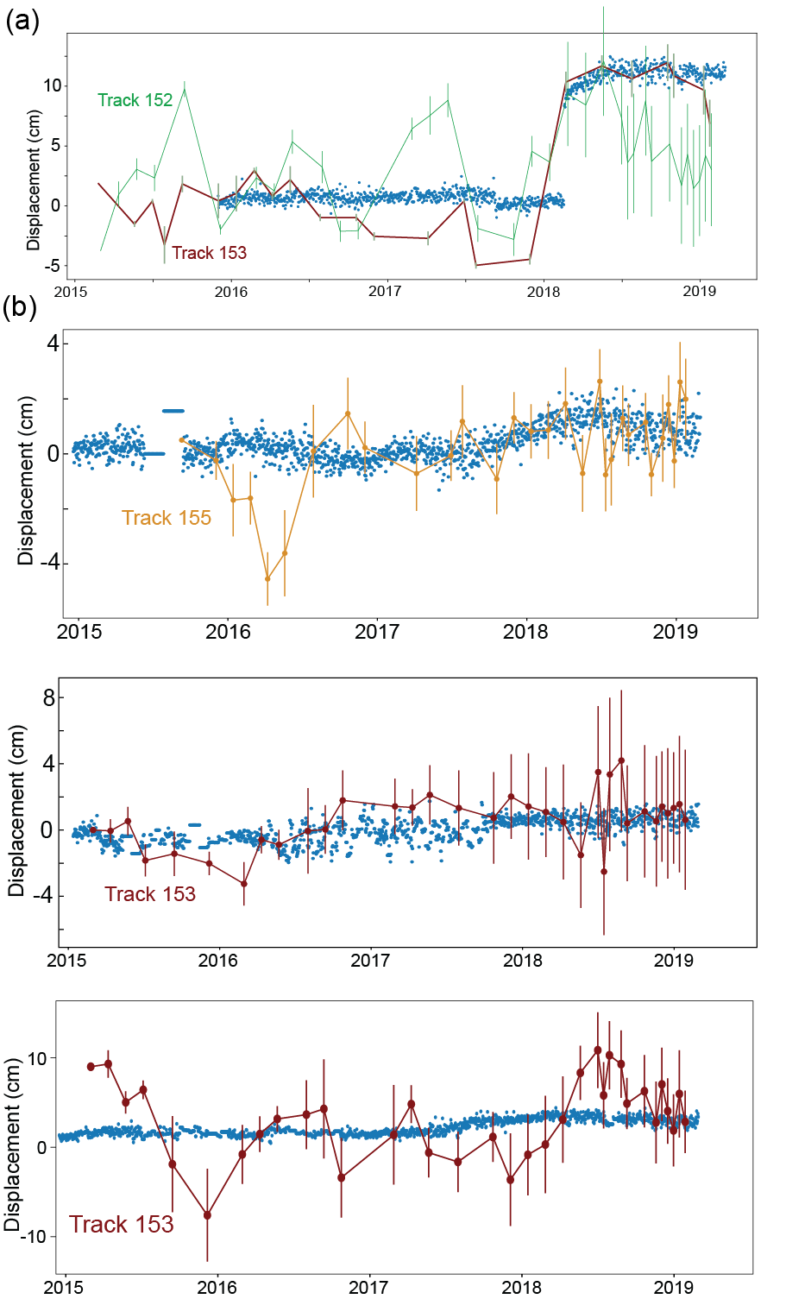
InSAR Time-series

Slide 47
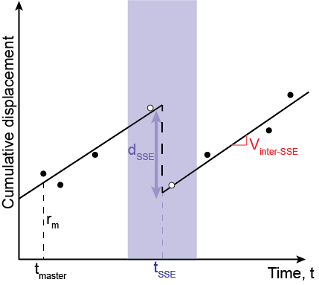
InSAR Time-series

Slide 48

InSAR Time-series

Slide 49


Calculating time-series
$$d=Gm$$
Where:
d is the interferometric phase
m is the (cumulative) displacement at each day
G is a matrix consisting of 0s and 1s:
Interferogram 1 = phase time 2 – phase time 1

Slide 50
Next week we will walk through an actual InSAR time-series calculation!

